Slide 1

Mathematical Optimization & Data Processing for Physical Constant Calibration via ML
Instantaneous thermal constant calibration with machine learning.
Alexandra Maria Titel
Curious Minds — Software Summer School 2026
Signal Processing & Algorithms

Slide 2


INTRODUCTION
Direct Inference from Sensor Data
Replacing iterative numerical solvers with direct ML inference.
Core Hypothesis
A model trained once, offline, can match classical solvers on accuracy while replacing their per-calibration search with a single forward pass.
Traditional calibration relies on expensive iterative solvers. We can extract physics-motivated features from the sensor window and map them to calibrated constants through a trained model.
Zero simulator rollouts per calibration.

Slide 3






PROBLEM STATEMENT
Why constant calibration?
Physical parameters degrade continuously. Uncalibrated models trigger false limits.
Material Wear
Fabrication Variance
Dynamic Conditions
Thermal degradation over time.
Individual manufacturing tolerances.
Changing ambient temperatures.

Slide 4
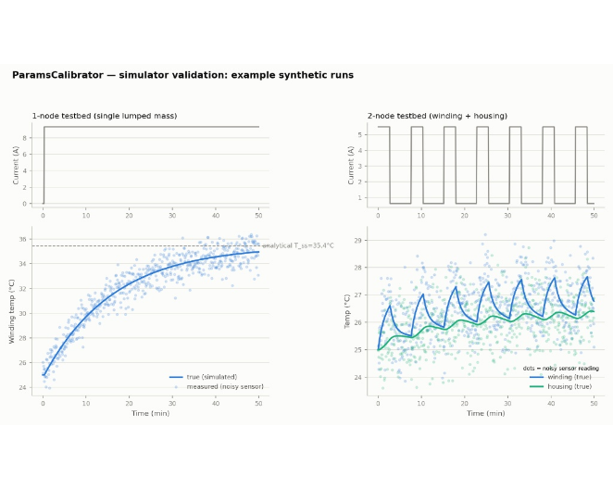


PHYSICS FUNDAMENTALS
Heat Transfer Dynamics
1-Node Model
Single thermal mass. Calibrates heat transfer hA.
2-Node Model
Winding and housing. Calibrates hA and conduction k_wh.

Slide 5

PHYSICS FUNDAMENTALS
Fundamental Equations
ENERGY BALANCE
C
hA
I²R
Thermal capacity.
Heat transfer (unknown).
Joule losses.

Slide 6



PHYSICS FUNDAMENTALS
Coupled Energy Balance
WINDING & HOUSING (2-NODE MODEL)
k_wh
hA
T_w & T_h
Internal conduction (unknown).
External convection (unknown).
Winding / Housing temps.

Slide 7


ARCHITECTURE 1/3
What the Model Actually Sees
1203 → 15
current (601) + measured temperature (601) + ambient (1) → 15 features
80× fewer numbers. The discarded part is the noise.
Physics anchor
Trust signals
Temperature rise
Load descriptors
Context
hA_energy_balance · hA_steady_state · hA_from_tau
tau_63 · initial_slope · final_slope
T_rise_final · T_rise_max · T_rise_mean
I_rms · I_mean · I_std · P_mean
T_ambient ·
noise_std_est

Slide 8
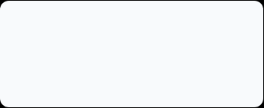

ARCHITECTURE 2/3
Training Scale & Generalization
7 600 motors
~1 000 params
1.52 seconds
per testbed — 6 000 train / 800 val / 800 test. 601 samples each.
15/24 → Dense(32) → Dense(16) → 1/2. Converged in 95 epochs via early stopping.
full training time on CPU for 2-node model. The expensive work is paid once, offline.
MAPE % | Train | Val | Test | Gap test-train
1-node hA | 1.773 | 1.820 | 1.815 | +0.04 pp
2-node hA | 1.754 | 2.002 | 1.817 | +0.06 pp
2-node k_wh | 3.570 | 3.930 | 3.895 | +0.33 pp

Slide 9

ARCHITECTURE 3/3
Residual MLP Correction
Never relearn basic physics.
The network predicts a residual correction on top of the closed-form physics estimator. Selected on validation over additive and unanchored variants
Forward pass
1. 15 features in
2. Standardize (train mean/σ)
3. 15 → 32 (ReLU) → 16 (ReLU) → 1 → single output: 0.3537
4. De-standardize → z = 0.011032
5. hA = anchor × exp(z) = 14.96 × 1.0111 → 15.13
Topology: Dense(32) → Dense(16)
Loss: Normalized MSE via Adam.
Failsafe: Defaults to pure physics.
Validation: unanchored 2.11% · additive 1.86% · multiplicative 1.82% error vs true hA

Slide 10


BASELINE ALTERNATIVES 1/2
Classical Calibration Solvers
Genetic Algorithm (GA)
Particle Swarm (PSO)
Levenberg-Marquardt
•
Population-based metaheuristic.
•
Swarm intelligence tracking.
•
Non-linear least squares.
•
Evolves candidate solutions.
•
Follows local/global bests.
•
Gradient-based curve fitting.
•
Explores global parameter space.
•
Continuous search mechanism.
•
Fits exact mathematical equations.
WHEN TO USE:
WHEN TO USE:
WHEN TO USE:
Non-convex search spaces. Unconstrained offline compute time.
Continuous search landscapes. Simpler tuning requirements.
Smooth mathematical models. Offline curve-fitting defaults.

Slide 11

BASELINE ALTERNATIVES 2/2
Sequential & Bayesian Solvers
Extended Kalman Filter
Bayesian Optimization
•
Sequential state update.
•
Gaussian Process surrogate.
•
Processes sample-by-sample.
•
Sample-efficient search optimization.
•
Real-time parameter tracking.
•
Balances exploration against exploitation.
WHEN TO USE:
WHEN TO USE:
Live streaming data. Immediate on-the-fly updates.
Highly expensive simulations. Critical evaluation limits.

Slide 12
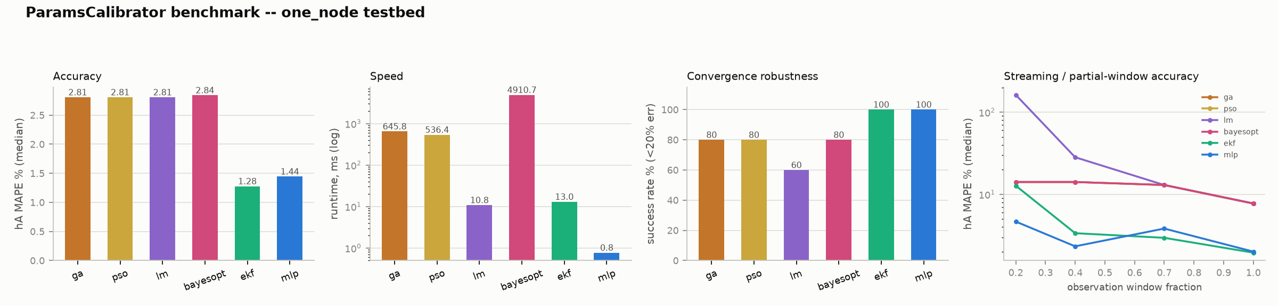
EVALUATION
1-Node Testbed Benchmark
Second-best accuracy behind EKF (0.16 pp away). Zero convergence failures. 0.77 ms — 14× faster than the next-best solver.

Slide 13
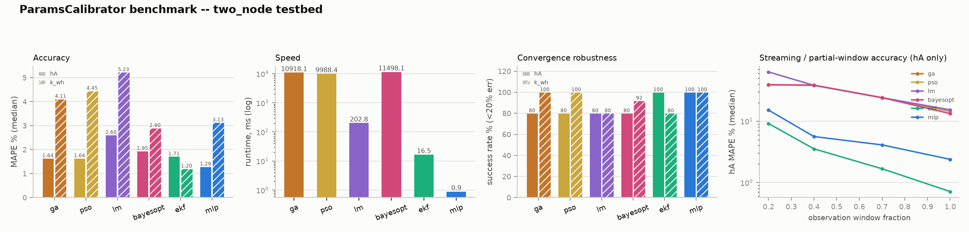
EVALUATION
2-Node Testbed Benchmark
Best accuracy on hA (1.29% median MAPE). EKF leads on the harder k_wh (1.20% vs 3.13%). 18.6× faster than the next best solver. Only method with 100% convergence on both parameters.

Slide 14
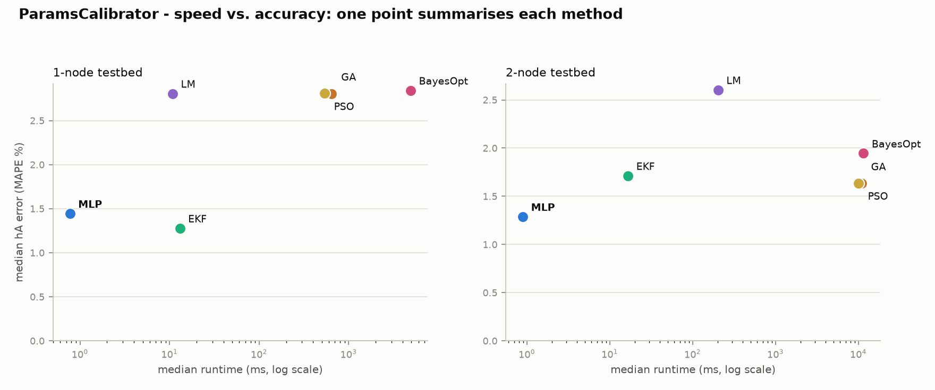
PERFORMANCE
Speed vs. Accuracy Trade-off
Bottom-left quadrant: only MLP and EKF combine low error with low latency. MLP at 0.77 ms, three orders of magnitude below the population heuristics.

Slide 15
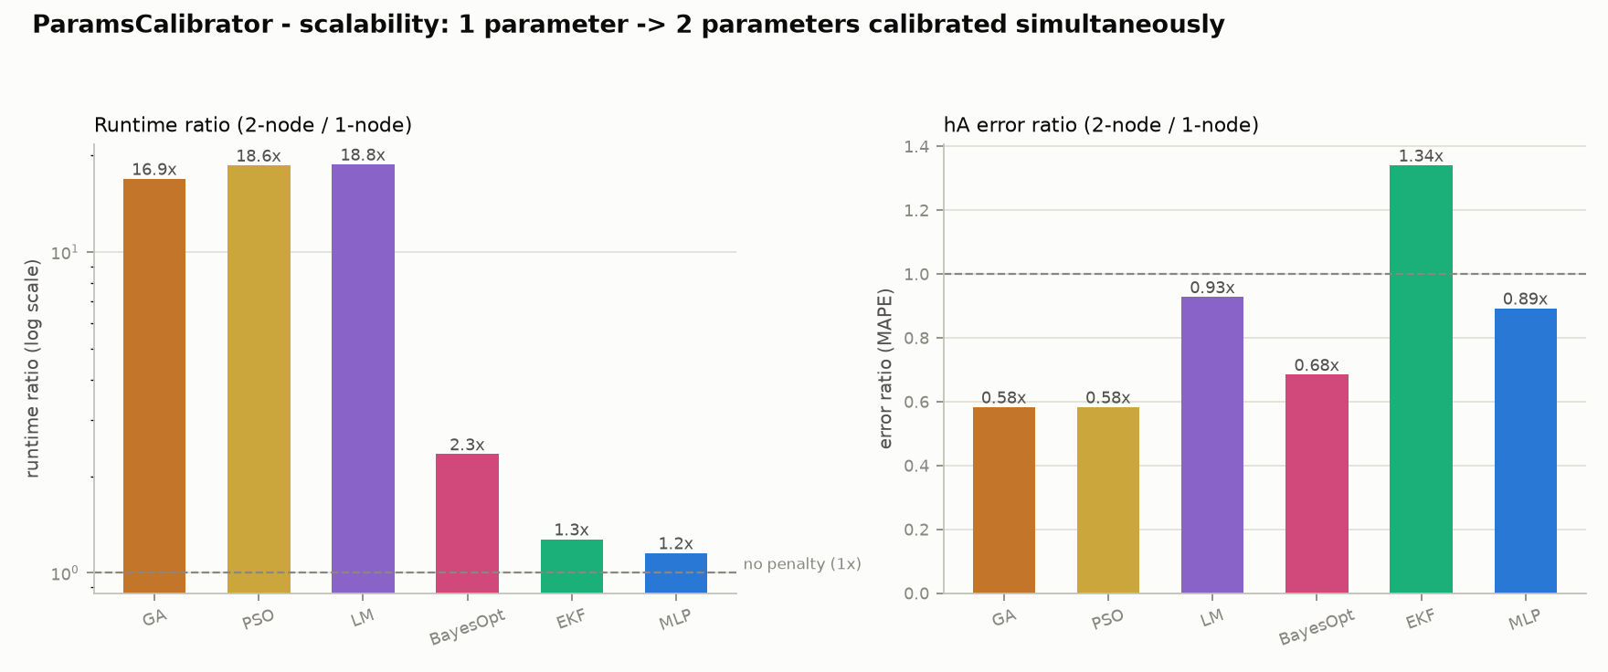
DIMENSIONALITY COST
Scalability Penalty (1 → 2 Parameters)
GA, PSO and LM pay a 17–19× latency penalty for one extra parameter. MLP (1.15×) and EKF (1.27×) are essentially unaffected; BayesOpt sits between at 2.3×.

Slide 16
EVALUATION
Where the Learning Actually Pays Off
Observation Window | Closed-Form Physics Error | Residual MLP Error
10% (300 s) | 58.3% | 23.5%
20% (600 s) | 21.1% | 13.5%
50% (1500 s) | 5.0% | 4.7%
100% (3005 s) | 1.79% | 1.81%
On a fully settled window the closed-form estimator is already near-optimal and the network only matches it. The gap opens widely as the window shortens — precisely the regime a live calibration operates in.

Slide 17



SUMMARY
Conclusions
The ML Advantage
Superior Robustness
Best Overall Trade-off
Zero simulator rollouts per calibration, against 520–1 100 for the population heuristics — the search cost is paid once, offline.
100% convergence success rate. Immune to randomized initialization faults.
Fastest, most reliable, least affected by dimensionality.

Slide 18
Thank you.
alexandra.titel17@gmail.com
github.com/titelaex/ParamsCalibrator
Mathematical Optimization & Data Processing for Physical Constant Calibration via ML

Slide 19
References
https://scikit-learn.org/stable/modules/generated/sklearn.neural_network.MLPRegressor.html
https://numpy.org/doc/stable/
https://en.wikipedia.org/wiki/Lumped-element_model
https://en.wikipedia.org/wiki/Joule_heating
https://en.wikipedia.org/wiki/Levenberg%E2%80%93Marquardt_algorithm
https://en.wikipedia.org/wiki/Genetic_algorithm
https://en.wikipedia.org/wiki/Particle_swarm_optimization
https://en.wikipedia.org/wiki/Extended_Kalman_filter
https://en.wikipedia.org/wiki/Bayesian_optimization

Slide 20



ENERGY BALANCE
Deriving the Formula
System differential equation
Integrate from 0 to t
E(t)
S(t)
Linear rearrangement (y = mx + intercept)
hA
→ hA is literally the slope

Slide 21


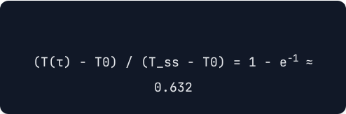

PHYSICAL FUNDAMENTALS
Why exactly 63.2%?
The Analytical Solution
The Time Constant (τ)
For a first-order step response, at exact time :
The moment you cover 63.2% of the rise is, by definition, the time constant.
T(t) = T_ss + (T0 - T_ss) · e-t/τ
Measure time → Obtain τ
hA = C / τ

Slide 22
CALCULATION MODELS
Estimator Comparison
Estimator | Formula | Information Used
hA_energy_balance | Slope of E(t) - C·T(t) vs ∫(T - T_amb) | Entire trajectory (integrated)
hA_steady_state | P_mean / (T_end - T_amb) | Final level only (settled)
hA_from_tau | C / τ_63 | Rising speed only (transition)

Slide 23

SCALING LAWS
Why Not Just Train Longer?
A. More data — fixed 32→16 network
Training runs | MAPE | RMSE
1 500 | 1.968% | 0.560
3 000 | 1.839% | 0.542
6 000 (shipped) | 1.815% | 0.533
12 000 | 1.766% | 0.517
24 000 | 1.775% | 0.515
Accuracy plateaus at ≈1.77% 4× the data buys just 0.04 pp, and a 43× larger network buys nothing.
The MLP cannot go below the closed-form estimator it is anchored to, because the anchor's per-run error is driven by that run's specific noise realisation — information discarded by the1203 -> 15 projection.
B. More capacity — fixed 24 000 runs
Architecture | Params | MAPE
32 → 16 | 1 057 | 1.775%
64 → 32 | 3 137 | 1.779%
128 → 64 | 10 369 | 1.787%
256 → 128 → 64 | 45 313 | 1.767%
EKF wins here
by processing all 601 samples sequentially with an explicit noise model. The limit is information, not training.

